Slide 1



The Determination of Water Resource Classes and Resource Quality Objectives (RQOs) in the Breede-Gouritz WMA
Presented by: E Lekalake
Department: Water & Sanitation
Date: 23 – 24 July 2018

Slide 2
Purpose of the meeting
To share the study objectives and processes that have been followed
To provide information on the conclusion of the study

Slide 3
Background: Classification and determination of RQOs
The classification and determination of the RQOs study in the Breede-Gouritz WMA was initiated in May 2016
Timeframe: 24 months
Aurecon South Africa (Pty) Ltd was appointed to assist DWS.
The objective of the study is to determine classes and set RQOs for water resources in the Breede-Gouritz WMA
(Rivers, Estuaries, Groundwater, Dams & Wetlands)

Slide 4
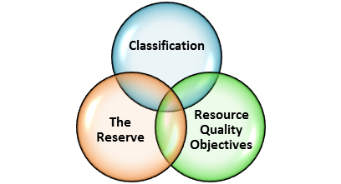
Legal Mandate
Chapter 3 of the National Water Act, (No. 36 of 1998) deals with the protection of water resources
The measures for protection of water resources are:
  Classification (S13)
  Reserve (S16)
  Resource Quality Objectives (S13)
S12 requires the Minister to establish the Water Resource Classification System, (WRCS)
WRCS was published as Regulation 810 in Government Gazette No. 33541 dated 17 September 2010
The WRCS defines:
  water resource classes and
  the procedure to determine Class, RQOs and Reserve
According to the NWA, once the WRCS has been gazetted all significant water resources must be classified and Resource Quality Objectives determined.

Slide 5
What are Water Resource Classes?
Classification defines the desired state of the water resources by setting Water Resource Classes;
Each class represents:
    a different level of protection that is required for the water resource, and
    the extent to which the water resource can be used.
Classification is used in two ways:
    To describe the present status of the water resource
    To describe the state towards which the water resource needs to be managed sustainably (future state).
 | Description of use | Majority of ecological categories
Class I | Minimally used | A-B
Class II | Moderately used | C
Class III | Heavily used | D
Ecological Category (EC) - means the assigned ecological condition to a water resource . It is measured by determining how much the ecosystem has changed from natural (pre-development condition). The scale is A (near natural) to F (critically modified)
5

Slide 6
How are Classes determined?
1
2
3
4
5
6
7
Assessment of WMA
Divided into catchment areas (IUAs) based on socio-economic/
land use characteristics/
water resources (IUAs)
Data assessed
Status quo understood
Value and condition of water resources
Goods and services assessed
Economic Framework for decision making developed
Ecological requirements of water resources understood and quantified
How much water does the ecology require for different protection levels
Models set up with ecological requirements and water requirements
Set and test a sustainable ecological protection level scenario for water resources
Set other scenarios (future states) and evaluate within the integrated water resource management context of WMA
Understand the implications of different protection levels
Evaluate the scenarios with the stakeholders
Stakeholders evaluate scenarios and agreed on shortlist
Recommended classes for the IUAs
Gazetting
Gazette the class configurations
We are here
COMPLETED
Stakeholder engagement

Slide 7
Summary of Key Study Milestones: Classes
    18 IUAs delineated:
    (10 in the Breede-Overberg & 8 in the Gouritz-Coastal areas)
    162 river and estuary nodes established
    Value and condition of water Resources linked
    Ecological Water Requirements quantified
    Various scenario identified & evaluated:
    (Spatially targeted scenario taken forward)
    Classes set for 18 IUAs
7

Slide 8
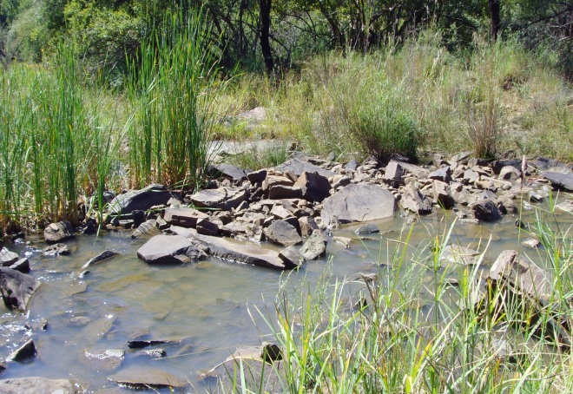
What are Resource Quality Objectives?
In essence:
  RQOs are the objectives or goals which can be measured or monitored to determine whether the Water Resource Class is being achieved.
8

Slide 9
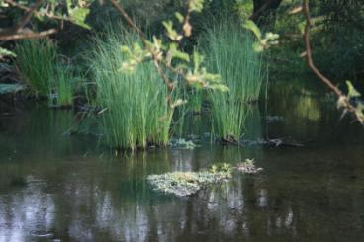
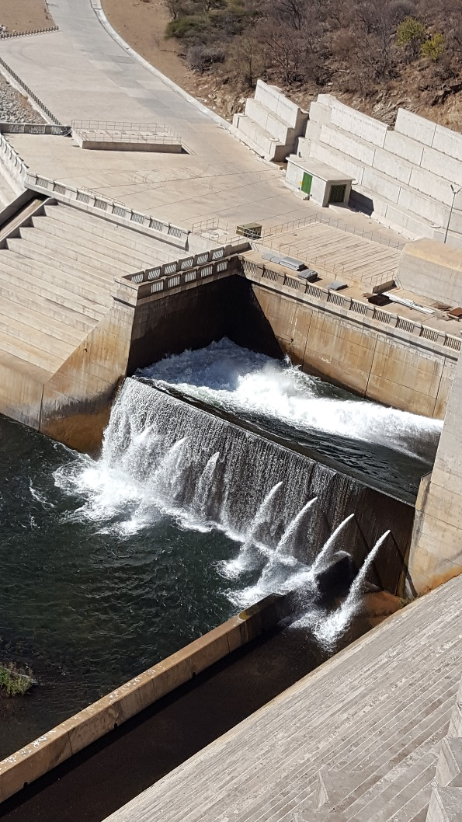
What are Resource Quality Objectives?
RQOs can be numerical and/or descriptive statements and may relate to:
  what the quantity of the water should be (water level, pattern, timing)
  what the water quality should be (physical, chemical and biological
  what the condition of the instream and riparian (river bank) habitat should be
  what the condition of the aquatic (water) animal and plant life should be.
9

Slide 10



Study Process & Progress: RQOs
RQOs 7-Step Procedure
: completed
: in progress
: next steps
1. Delineate the IUAs and RUs
2. Establish the vision for the catchment
3.
Prioritise & select RUs
4. Prioritise sub-components, select indicators & propose direction of change
5. Develop draft RQOs & numerical limits
6. Agree RUs, RQOs & numerical limits with stakeholders
Monitoring & Compliance
7. Finalise & Gazette

Slide 11
FOR WHICH COMPONENTS AND INDICATORS ARE RQOs SET?

Slide 12
COMPONENTS AND SUB COMPONENTS
(RIVERS, DAMS, WETLANDS, ESTUARY)
WATER QUANTITY
High Flows
WATER QUALITY
Nutrients
HABITAT
Instream Habitat
Riparian Habitat
BIOTA
Low Flows
Salts
System Variables
Toxics
Pathogens
Aquatic and Riparian plant species
Mammals
Birds
Periphyton
Aquatic Invertebrates
Fish
Diatoms

Slide 13
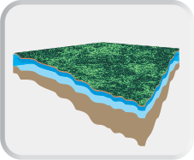
COMPONENTS AND SUB COMPONENTS
(GROUNDWATER)
Measurable parameters including:
Quantity (Abstraction),
Aquifer Water Level,
Water Quality, and
Protection Zones (related to a localised borehole as a means of protecting the basic human needs and the ecological Reserve).

Slide 14
Summary of Key Study Milestones: RQOs
73 resource units were prioritised for the setting of RQOs (Breede-Overberg)
17 Rivers
11 Estuaries
6 Dams
12 Wetland
27 Ground water

Slide 15
Summary of Key Study Milestones: RQOs
68 resource units were prioritised for the setting of RQOs (Gouritz-Coastal)
20 Rivers
23 Estuaries
2 Dams
9 Wetland
14 Ground water

Slide 16
Stakeholder Engagement
Public Consultation meeting - 15 -16 November 2016
1st Project Steering Committee meeting - 14 February 2017
2nd Project Steering Committee meeting - 29 November 2017
1st Technical Task Group meeting – 24 April 2017
2nd Technical Task Group meeting – 12 -16 March 2018
Estuary sector meeting – 19 April 2018
Agriculture sector meeting – 24 May 2018
Municipality sector meeting – 13 June 2018
3rd PSC Project Steering Committee meeting – 12 June 2018
Public meetings – 23 -24 July 2018
All issues and responses are being captured in a register (ongoing)

Slide 17
Study Information
For more information visit the Departmental website:
www.dwa.gov.za/rdm/WRCS/default.aspx
E-mail : Lekalakee@dws.gov.za
Erik.VanDerBerg@aurecongroup.com
      Bea Whittaker : BGClassRQO@gmail.com

Slide 18
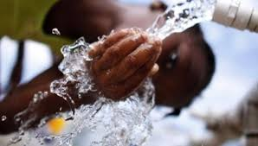
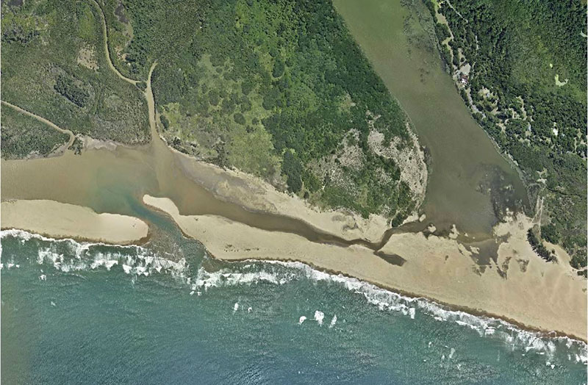
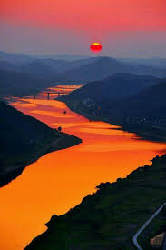
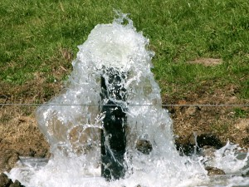
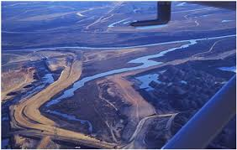
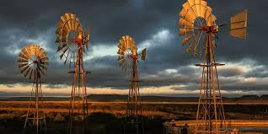
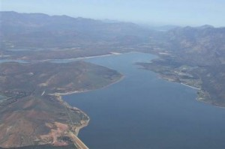
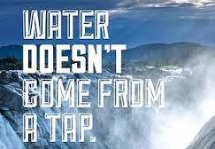

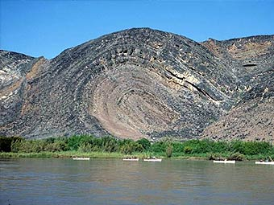

THANK YOU!
Estuaries
Rivers
Groundwater
Wetlands
Dams

Slide 19
Way forward
Gazetting process has started
All issues and responses are being captured in a register (ongoing)

